Slide 1


The US Real Estate Market: An Exploratory Data Analysis
Chris Tanner, Noah Eiseman &
Joseph Lomas

Slide 2

Overview
The Zillow’s public data files include datasets on home value, rental prices, sales, and other valuable statistics that can be used to evaluate the U.S. residential home market.
Data is available for all 50 states and close to 1,000 U.S regions.
Datasets used:
Zillow Observed Rent Index
Median Sale Price
Home Value Forecast
Days to Close
Percent of Sales Over List
Main Questions:
Where is it best to rent vs. buy?
Where is it best to be a buyer vs. seller?

Slide 3
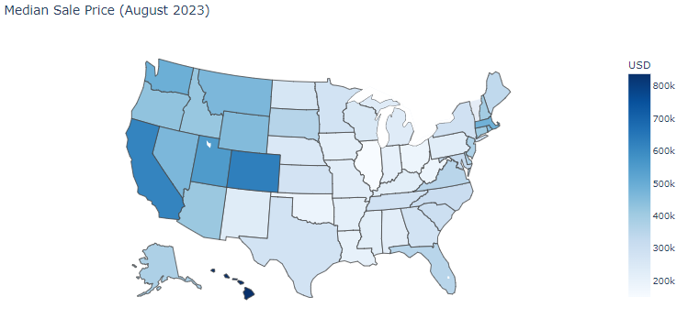
Median sale price varies by region, with the West Coast experiencing higher sale prices than the East Cost
Hawaii, California, and Colorado lead the U.S. in median sale price
Hawaii’s median sale price is more than $100,000 greater than California’s median sale price. The combination of low housing supply and high demand for homes in Hawaii drives the price up.
California and Colorado are highly desirable states for home buyers that are looking for primary residents and vacation homes

Slide 4
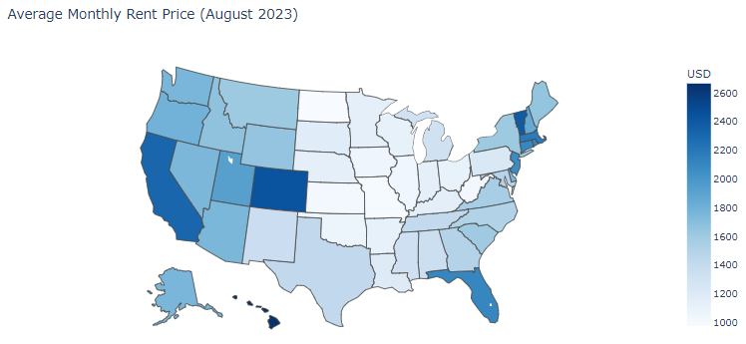
The regional trend somewhat holds up when looking at average monthly rent, with Hawaii, California, and Colorado leading, but East Coast states like Florida and Massachusetts also have high monthly rental rates.
In Massachusetts, Boston is home to leading college institutions and industry leaders like Microsoft, StateStreet, and Amazon that drive rental prices up
In Florida, advantageous tax laws and demand for homes close to the beach translates to higher rental prices
Furthermore, New Jersey’s proximity to New York City drives up rental prices specifically in North Jersey

Slide 5
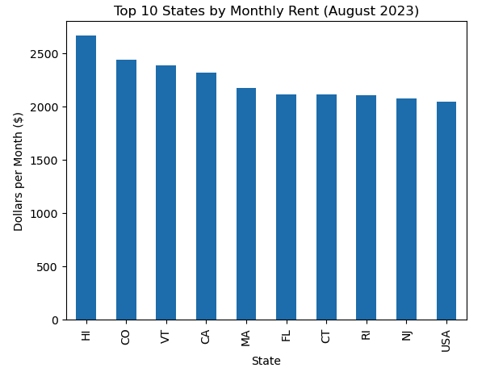
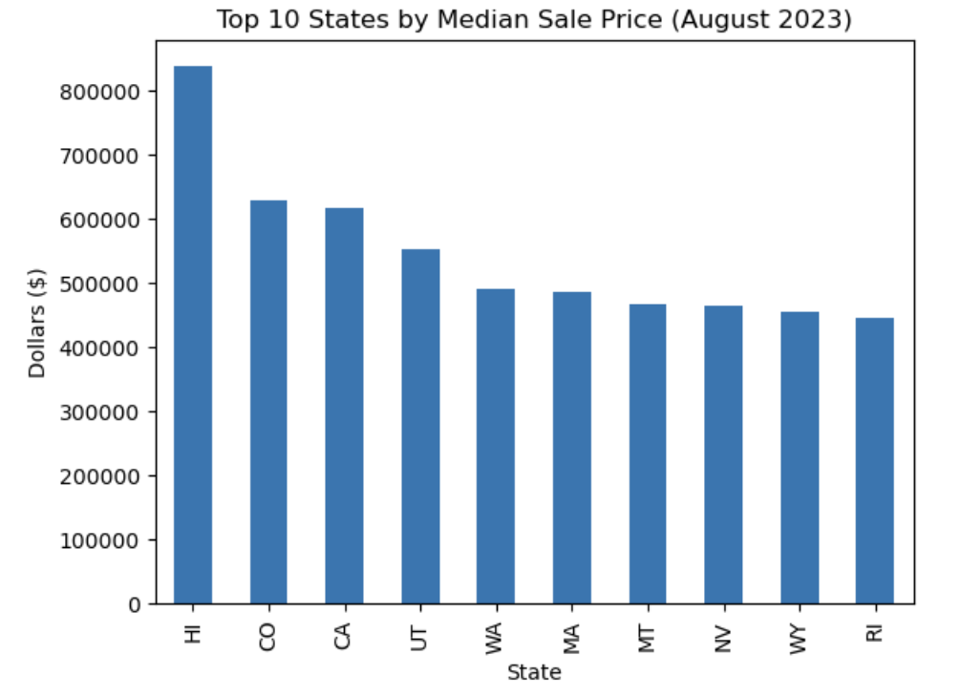
Rent Comparison

Slide 6
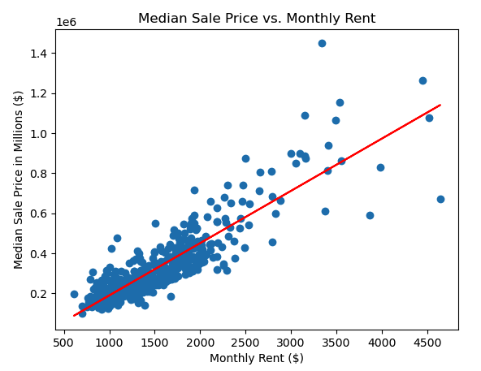
The correlation between the rent price and median sale price is 0.87
The chart to the left shows a scatter plot of median sale price and monthly rent, showing the two variables are highly correlated
As monthly rent increases in a region, so does the median sale price
Where is it better to be a renter? In regions above the red line.
Where is it better to be a homeowner? In regions below the red line.

Slide 7
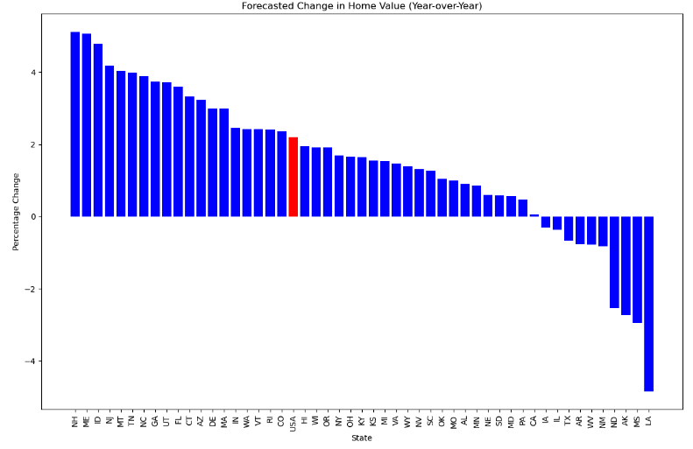
Top 5 Increase
New Hampshire
Maine
Idaho
New Jersey
Montana
Top 5 Decrease
Louisiana
Mississippi
Arkansas
North Dakota
New Mexico

Slide 8
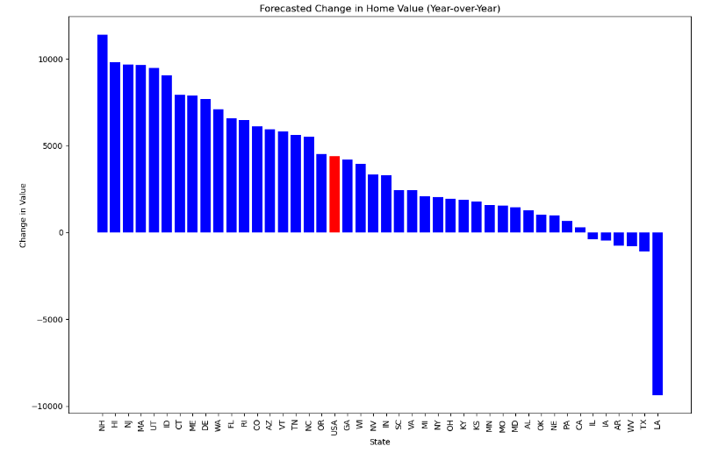
Top 5 Increase
New Hampshire
Hawaii
New Jersey
Massachusetts
Utah
Top 5 Decrease
Louisiana
Texas
West Virginia
Arkansas
Iowa
Change in Value =
Average Home Value *
(1 + Percent Value Change)

Slide 9
Percent & Value
Percent Top 11
NH 5.12%
ME 5.07%
ID 4.78%
NJ 4.17%
MT 4.04%
TN 3.98%
NC 3.88%
GA 3.73%
UT 3.72%
FL 3.59%
Numeric Top 11
NH $11,396.61
HI $9819.95
NJ $9685.39
MA $9653.55
UT $9482.98
ID $9049.18
CT $7918.54
ME $7878.84
DE $7697.81
WA $7092.61
FL $6582.93

Slide 10
Percent & Value
Percent Bottom 6
LA -4.841%
WV -0.771
AR -0.775%
TX -0.670%
IL -0.361%
IA -0.305%
Numeric Bottom 6
LA -$9367.68
TX -$1091.19
WV -$788.83
AR -$771.66
IA -$476.20
IL -$394.13
No Given Home Value:
MS -2.940%*
AK -2.725%*
ND -2.528%*
NM -0.827%*

Slide 11
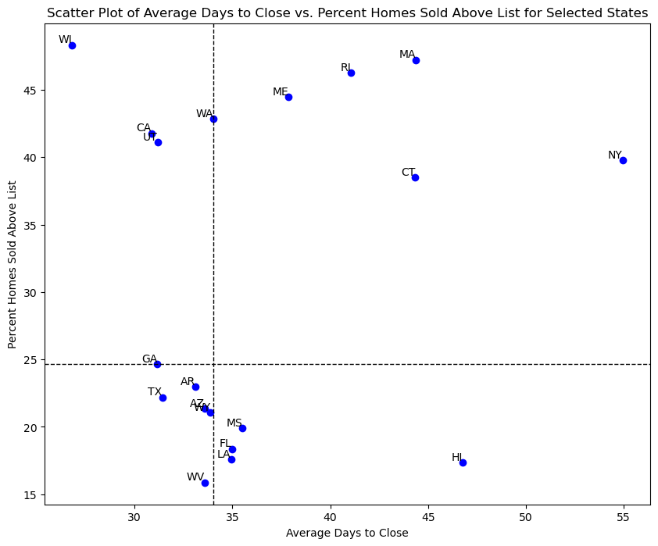




Average Days to Close is defined as the number of days between the listing going pending and the sale date.
Percentage of Homes Sold Above List is defined as the percentage of homes that were sold above the original price listed on Zillow.
The relationship between these two variables give insight into whether the market is better for a buyer or a seller.
Days to Close is impacted by factors like home inspection, home appraisal, and overall ease of process with buyer, seller and agent.
Percent Above Listing indicates the competitiveness of the market.
The Zones are defined below:
1. Advantage to the seller
2. Advantage to the seller – lesser extent
3. Advantage to buyer
4. Advantage to buyer – lesser extent

Slide 12
Best for Sellers (Quadrant 1):
- Wisconsin
- California
- Utah
- Washington
Best for Buyers (Quadrant 3):
- Texas
- Georgia
- Arkansas
- Arizona

Slide 13
Let’s Answer Our Questions

Slide 14

Where do you want to be a buyer?
New Jersey:
Median Sale Price = 9th
Rental Price = 8th
Forecasted Home Value = Top 5
Below Average Home Sold Above Listing
According to Houzeo, buyers in New Jersey have the upper hand, with the housing market slowing down compared to the post-pandemic highs. New Jersey is representative of the entire U.S. market with high demand and low supply, but the high rental prices and forecasted home value might prove it be worth it for buyers who are looking for primary residency and investors.
Notes:
https://www.houzeo.com/blog/new-jersey-real-estate-market/

Slide 15
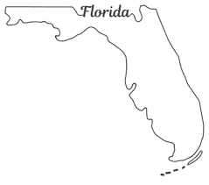
Where do you want to be a buyer?
Florida:
Rental Price = 6th
Forecasted Home Value = Top 10
4th Lowest in Percent Sold Above Listing
Florida is attractive for buyers due to its warm weather and relatively low cost of living. Home value and rental price growth makes it an attractive market for primary residents and investors. There are unique risks to the Florida market, specifically related to high cost of homeowners insurance.
Notes:
https://www.bankrate.com/real-estate/housing-market/florida/

Slide 16

Where do you want to be a buyer?
Arizona:
7th Lowest Percent Sold Above Listing
Forecasted Home Value = Top 15
Low Closing Time
Arizona’s economy is attracting new business and government investment. Taiwan Semiconductor Manufacturing Co is investing $40 billion for a new chip facility in Phoenix. The Infrastructure Investment and Jobs Act accumulated $500 million dollars for other construction projects in Arizona. Investment in the state will create new jobs and higher demand for homes.
Notes:
https://www.forbes.com/advisor/mortgages/real-estate/arizona-housing-market/

Slide 17

Where do you want to be a seller?
Wisconsin:
2nd Highest in Percent Sold Above Listing
Lowest Average Days to Close
Above Average Home Value (16th)
High percentage sold above listing with a low average number of days to close make Wisconsin a great market for sellers. Wisconsin suburbs are an attractive location for people looking to move to the suburbs. This gives opportunity for home seller to capitalize on demand.

Slide 18

Where do you want to be a seller?
California:
7th Lowest in Forecasted Value Increase
Lowest of All Positive States
Only Top 10 State in Median Sale Price that is also bottom 20% in Home Value Increase
7th Highest Percent of Sold Above Listing
2nd Lowest Average Days to Close
Real estate prices are some of the highest in the country limiting forecasted value increase. Homeowners can capitalize on the high demand and high home value by selling their homes.
Notes:
https://www.wkow.com/news/wisconsin-housing-market-remains-tight-realtors-offer-advice-for-first-time-buyers/article_933c0dec-1144-11ee-a4a8-57d051a0e338.html

Slide 19
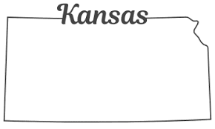
Where do you want to be a seller?
Kansas:
3rd Lowest Rent
Top 20 in Percent Sold Above Listing
Bottom Half in Forecasted Home Value
Bottom 15 in Numerical Increase
Bottom 10 in Percentage Increase
According to Fox Business, Topeka, the capital of Kansas, is ranked as a top emerging housing market in the US. While home values are growing below the US average, demand is high making it a good time to be a seller.
Notes:
https://www.foxbusiness.com/lifestyle/kansas-capital-top-emerging-housing-market-us

Slide 20
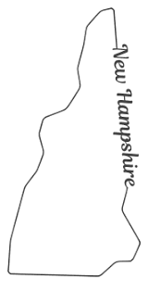
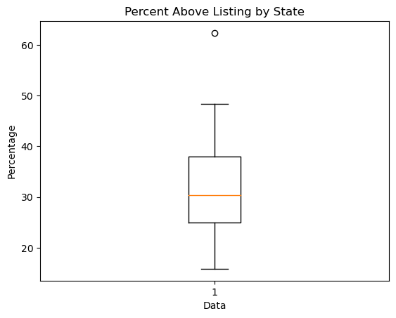
Where do you want to be a buyer and seller?
New Hampshire:
Leading in Home Value Forecast
Leading Percentage Sold Above Listing
Top 10 in Rent
New Hampshire is the perfect storm for both buyers and sellers. Demand for homes is driven by growth in home value which is attractive for residential buyers and high rent which is attractive for investors. A leading percentage sold above listing indicates that sellers' homes are getting bid higher than expected.

Slide 21
Conclusion
Median home sales and rental prices are led by states on the East and West Coast. These two variables are highly correlated, indicating that being a renter or a buyer is less about where you are located, and more about other factors like income and interest rates.
The three key factors we considered when looking at whether it is better to be a buyer or a seller are home value forecast, percent homes sold above listing, and days to close.
New Jersey, Florida, and Arizona are best if you are a buyer due to high demand, high forecasted home values, and economic and demographic changes that make the states attractive
Wisconsin, California, and Kansas are best if you are a seller due to high percent sold above list coupled with low forecasted home value

Slide 22
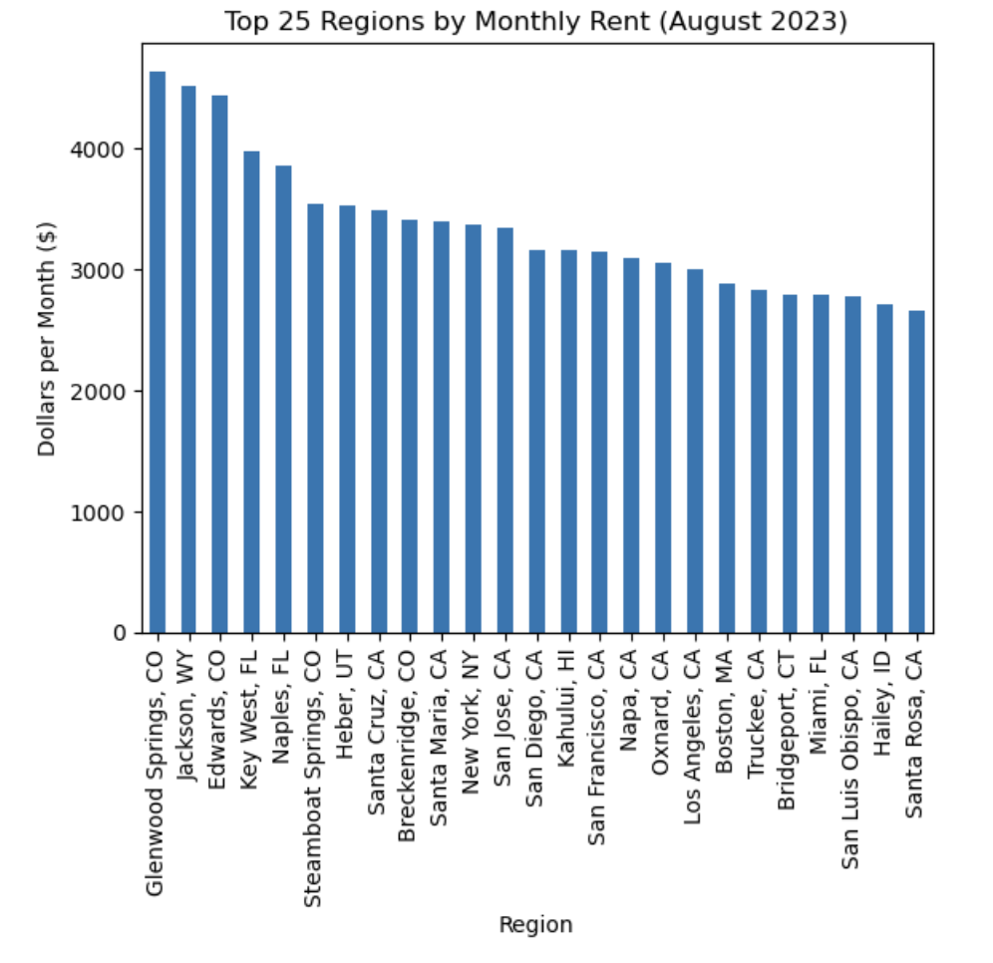
Appendix: Top Monthly Rent

Slide 23
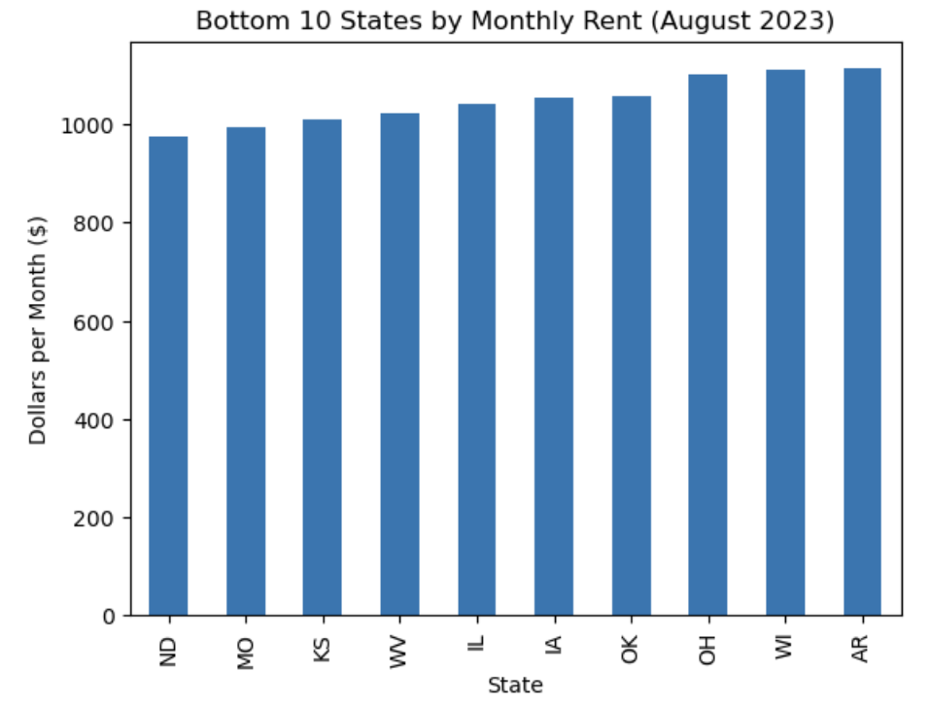
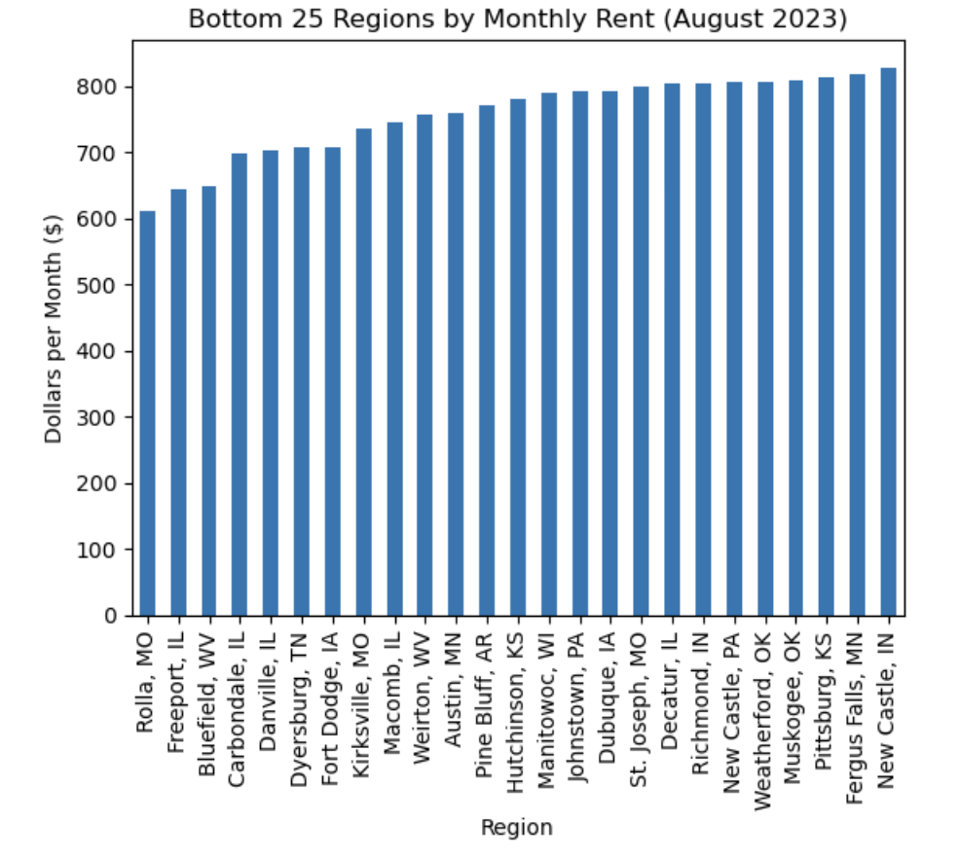
Appendix: Bottom Monthly Rent

Slide 24
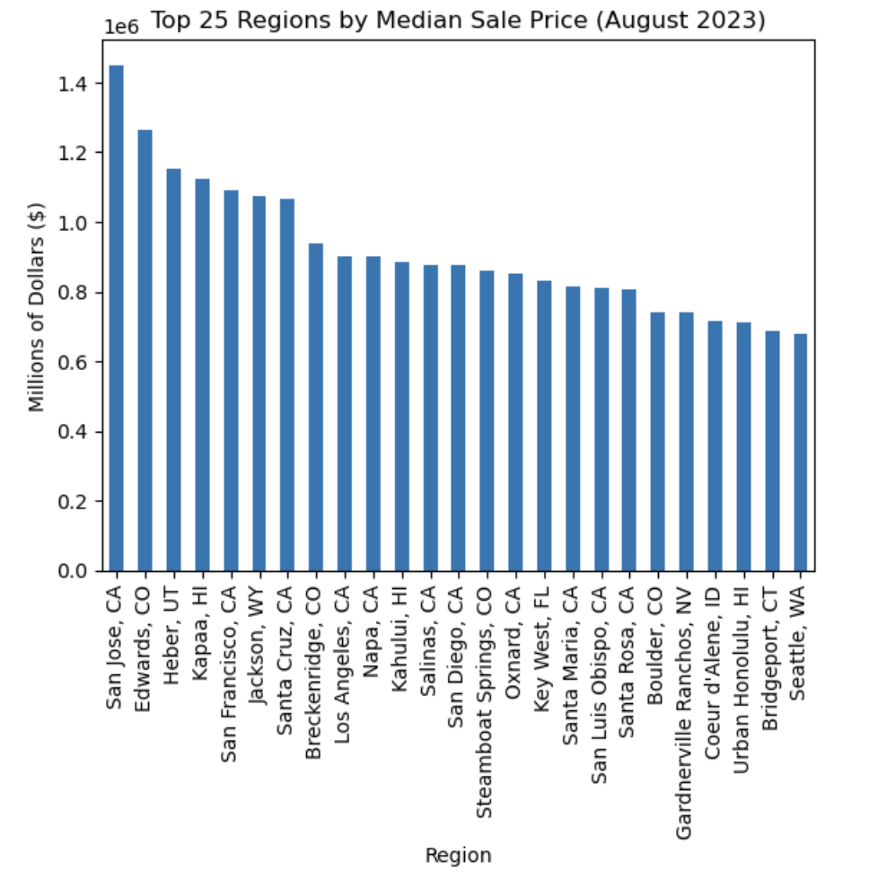
Appendix: Top Median Sale Price

Slide 25
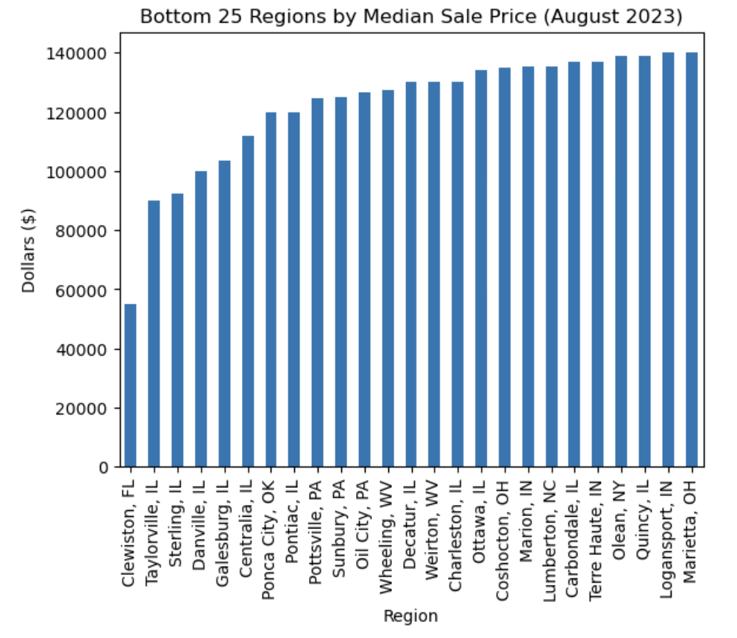
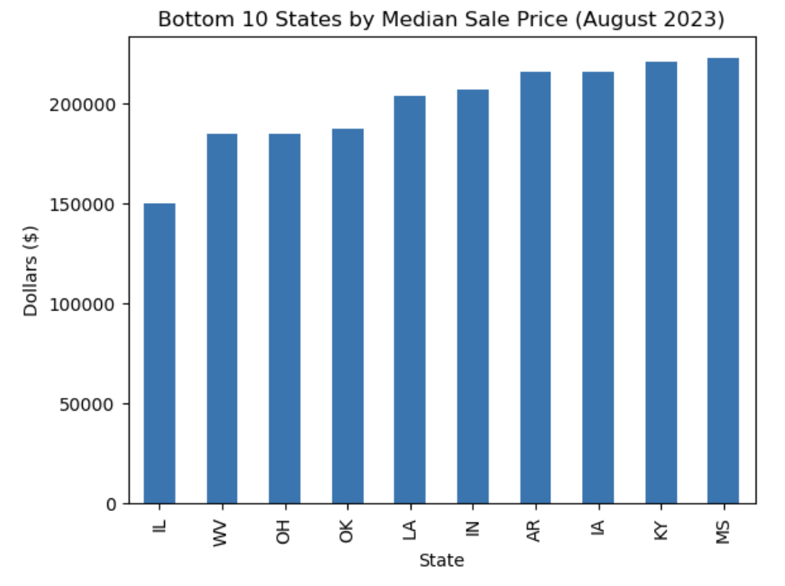
Appendix: Bottom Median Sale Price

